Slide 1
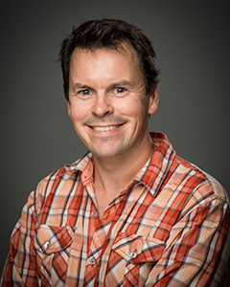
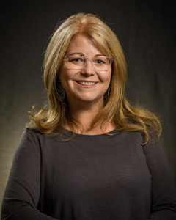
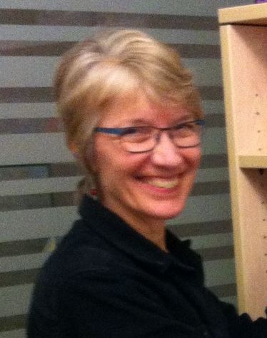
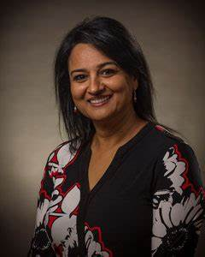
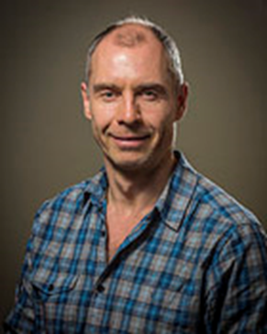
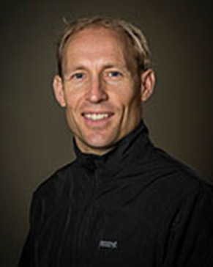
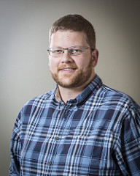
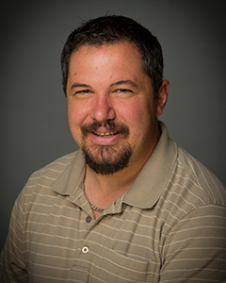
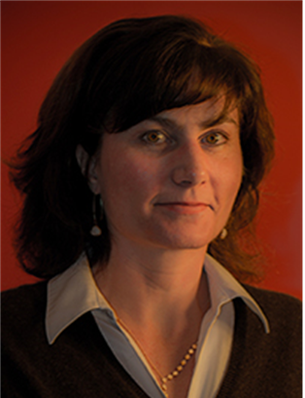
  Chris Ayles, A&S
Jeanne Puritch, HHS
  Chrisa Hotchkiss, Learning Services
Mandy Hayre, HHS
  Sue Doner, Learning Services
  Ian Browning, T&T, A&S
  Tony Webster, CSEE
  Frank Jankunis, A&S
  Blair Fisher, School of Arts & Science

